Slide 1
Embedded Hardware: Hardware Building Blocks
Basics

Slide 2
Topics to be discussed
Basic Notations describing hardware design
Diagrams
Symbols
Embedded Board
Von-Neumann Model
Semiconductors
Active Building Blocks of Processors and Memory

Slide 3
Diagrams
Created by hardware engineers
Used to describe the hardware designs to the outside world.
Block diagram
A basic overview of the hardware, with implementation details abstracted out.
Schematics
Electronic circuit diagrams that provide a more detailed view of all of the devices within a circuit or within a single component—everything from processors down to resistors.
Wiring diagrams
Represent the bus(represented by vertical and horizontal lines) connections between the major and minor components on a board or within a chip.

Slide 4
(Cntd..)
Logic diagrams
are used to show a wide variety of circuit information using logical symbols (AND, OR, NOT, XOR, and so on), and logical inputs and outputs (the 1’s and 0’s).
Timing diagrams
display timing graphs of various input and output signals of a circuit, as well as the relationships between the various signals.

Slide 5
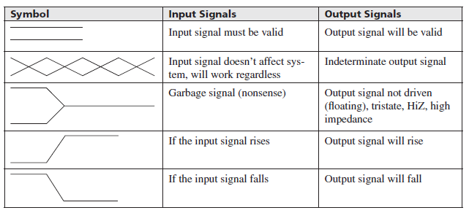
Symbols
Regardless of the type, in order to understand how to read and interpret these diagrams, it is first important to learn the standard symbols, conventions, and rules used.
Timing diagrams symbol table

Slide 6
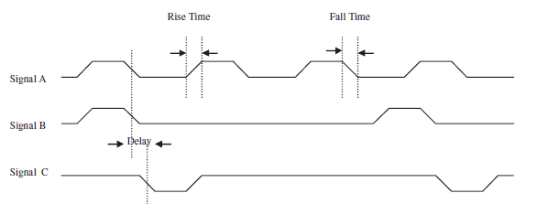
Timing diagram example

Slide 7
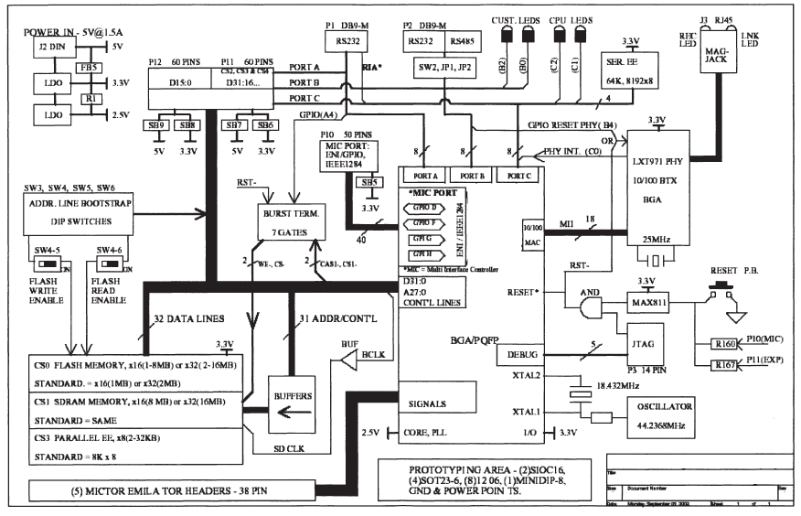
Schematic diagram example

Slide 8
The Embedded Board and the von Neumann Model
In embedded devices, all the electronics hardware resides on a board, called printed circuit board (PCB).
Major hardware components of most boards can be classified into five major categories:
Central Processing Unit (CPU) – the master processor
Memory – where the system’s software is stored
Input Device(s) – input slave processors and relative electrical components
Output Device(s) – output slave processors and relative electrical components
Data Pathway(s)/Bus(es) – interconnects the other components, providing a “highway” for data to travel on from one component to another, including any wires, bus bridges, and/or bus controllers

Slide 9
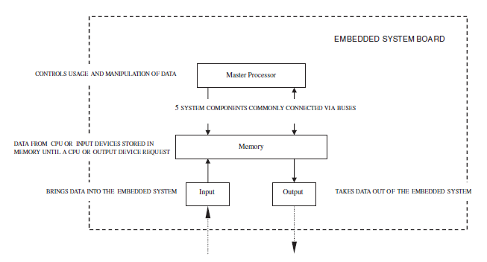
Von Neumann model
A tool that can be used to understand any electronic device’s hardware architecture.
John von Neumann in 1945, defined the requirements of a general-purpose electronic computer.
Because embedded systems are a type of computer system, this model can be applied as a means of understanding embedded systems hardware.
Embedded system board organization

Slide 10
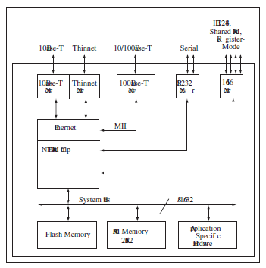
Net Silicon ARM7 reference board

Slide 11
Semiconductors
Materials whose base elements have a conductive nature that can be altered by introducing other elements (impurities) into their structure.
Example- silicon, germanium etc.
It can be of 2 basic types:
P-type
Impurities called acceptors, such as boron, produce a shortage of electrons, creating a P-type semiconductor material.
N-type
Impurities (like arsenic, phosphorus, antimony, etc.), called donors, create a surplus of electrons creating an N-type semiconductor.

Slide 12
Active Building Blocks of Processors and Memory
P-type and N-type semiconductors must be combined in order to be able to do anything practical.
When P-type and N-type semiconductors are combined, the contact point, called the P-N Junction,
Acts as a one-way gate
Allow electrons to flow within the device in a direction dependent on the polarity of the materials.
P and N-type form some of the most common basic electronic devices that act as the main building blocks in processor and memory chips:
Diodes
Transistors

Slide 13
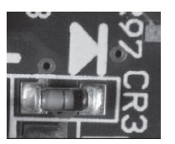
(Cntd…)
Diodes-
Semiconductor device made up of two materials, one P-type and one N-type joined together. A terminal is connected to each of the materials, called an anode and a cathode.
Forward biasing
Current flows through a diode from the anode to cathode as long as the anode has a higher (positive) voltage
Reverse biasing
When current will not flow through the diode because the cathode has a higher (positive) voltage than the anode
Diode and light emitting diode (LED)

Slide 14
(Cntd…)
Transistor
current-transferring resistor
Made up of some combination of P-type and N-type semiconductor material, with three terminals(emitter, base, and a collector) connecting to each of the three materials.
used for a variety of purposes,
current amplifiers (amplification),
in oscillators (oscillation),
in high-speed integrated circuits (ICs)
and/or in switching circuits(DIP switches, push buttons)

Slide 15
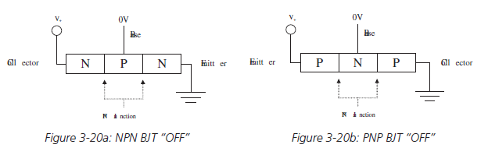
(Cntd…)
Two main types of transistors are:
Bipolar junction transistor (BJT)
Made up of three alternating types of P-type and N-type material,
Are sub-classed based on the combination of these materials.
NPN BJT
is made up of two sections of N-type material, separated by a thin section of P-type material
PNP BJT
is made up of two sections of P-type materials, separated by a thin section of N-type material

Slide 16
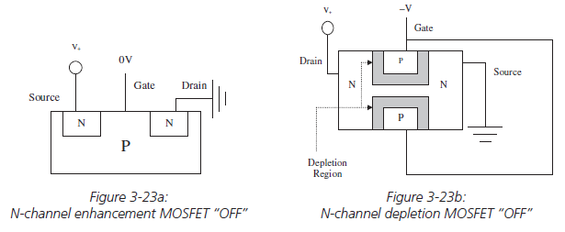
(Cntd…)
Field effect transistor (FET)
Made up of some combination of P-type and N-type semiconductor material, with three terminals
The terminals are called a source, a drain/sink, and a gate.
FETs do not require a biasing current, and are controlled via voltage alone.
The 2 most common types:
Metal-Oxide-Semiconductor FET(MOSFET)
Junction field-effect transistor (JFET).

Slide 17
Thank you

